Slide 1
GESTALT
Geospatially Enhanced Search with Terrain Augmented Location Targeting
ACM SIGSPATIAL GEOSEARCH WORKSHOP
Kent O’Sullivan | Nicole Schneider | Aleeza Rasheed | Hanan Samet
13 Nov 2023

Slide 2
Presentation Scope
Problem motivation.
GESTALT Architecture.
Data Acquisition.
Object-Ownership Assignment.
Demo of GESTALT.
Experiments.
Future Directions.

Slide 3
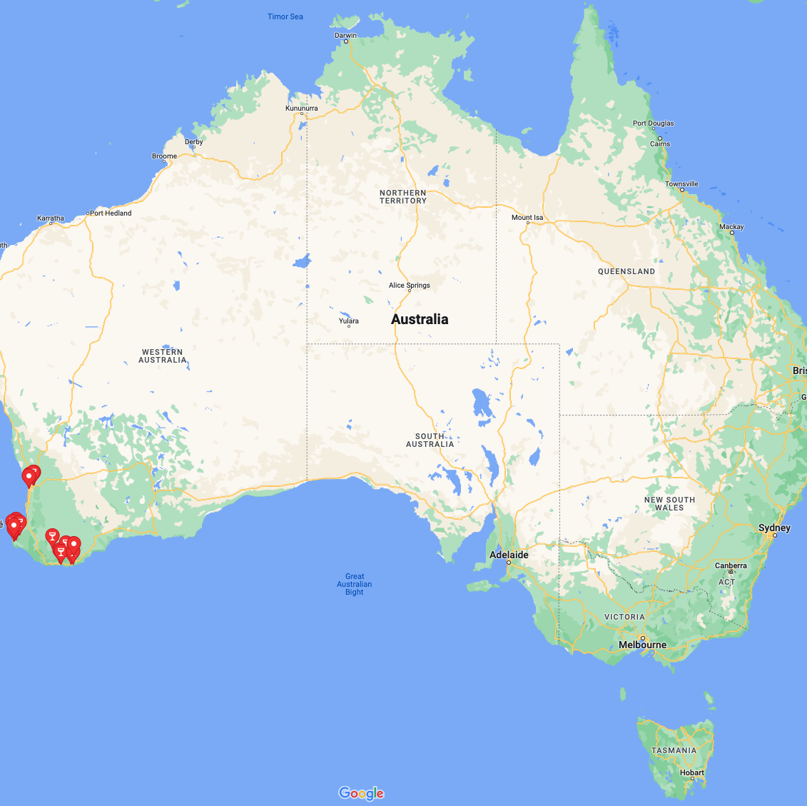
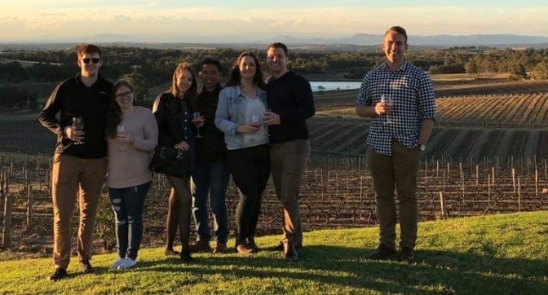
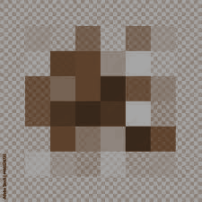
Motivating example
On the merits of wine tours…
Notes:
Intro:
We spend a lot of time ’finding’ places.
Current solutions can give us an exact match or a shortlist.
Current solutions don’t do well with partial information.
Humans currently fill the gap. Why should we?
Has Anyone Been on a Wine Tour before?
Explain basic idea
You visit a lot of places, the reason you do it is because you want to be able to go back, or at least buy their wine. But because we don’t do any of the organising and are busy socializing… sometimes you don’t remember all the detail.
With only a few anchoring memories about the places you’ve been… how do we find our way back?

Slide 4
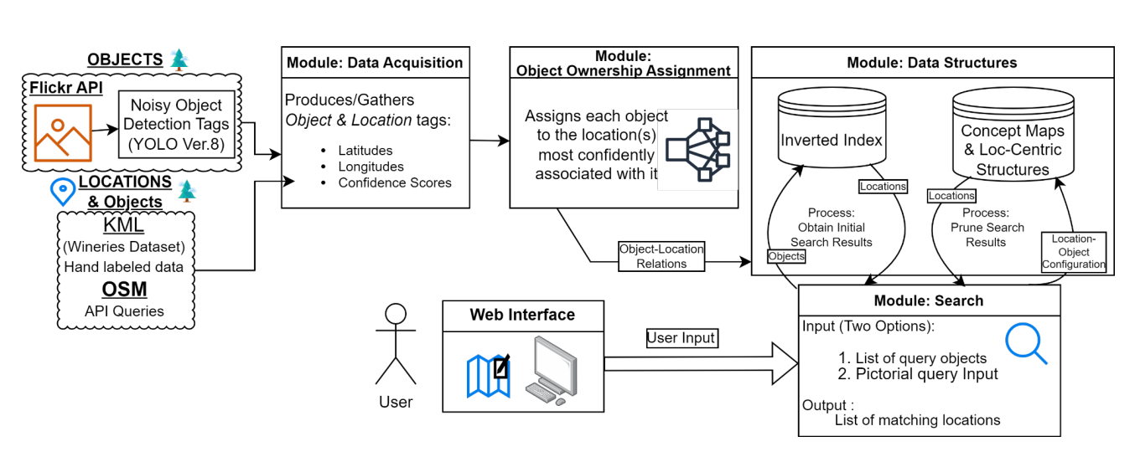
GESTALT Architecture
Data collection, Ownership-Assignment, and User Interface
Notes:
We are looking at three components:
Data Collection
Ownership Assignment
UI

Slide 5
GESTALT Architecture
Data collection, Ownership-Assignment, and User Interface
Notes:
We are looking at three components:
Data Collection
Ownership Assignment
UI

Slide 6
GESTALT Architecture
Data collection, Ownership-Assignment, and User Interface
Notes:
We are looking at three components:
Data Collection
Ownership Assignment
UI

Slide 7
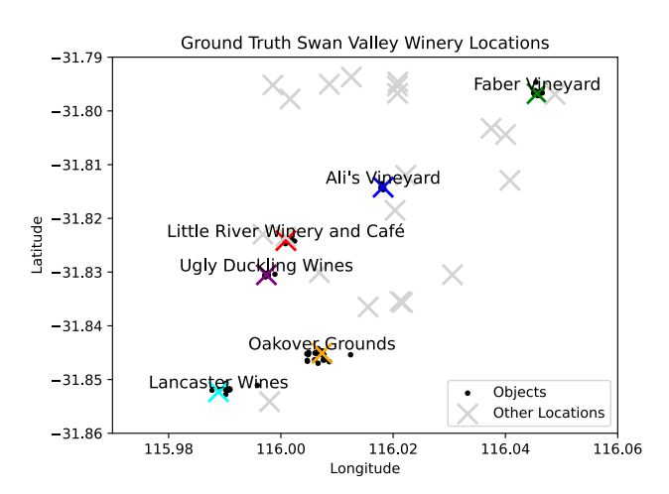
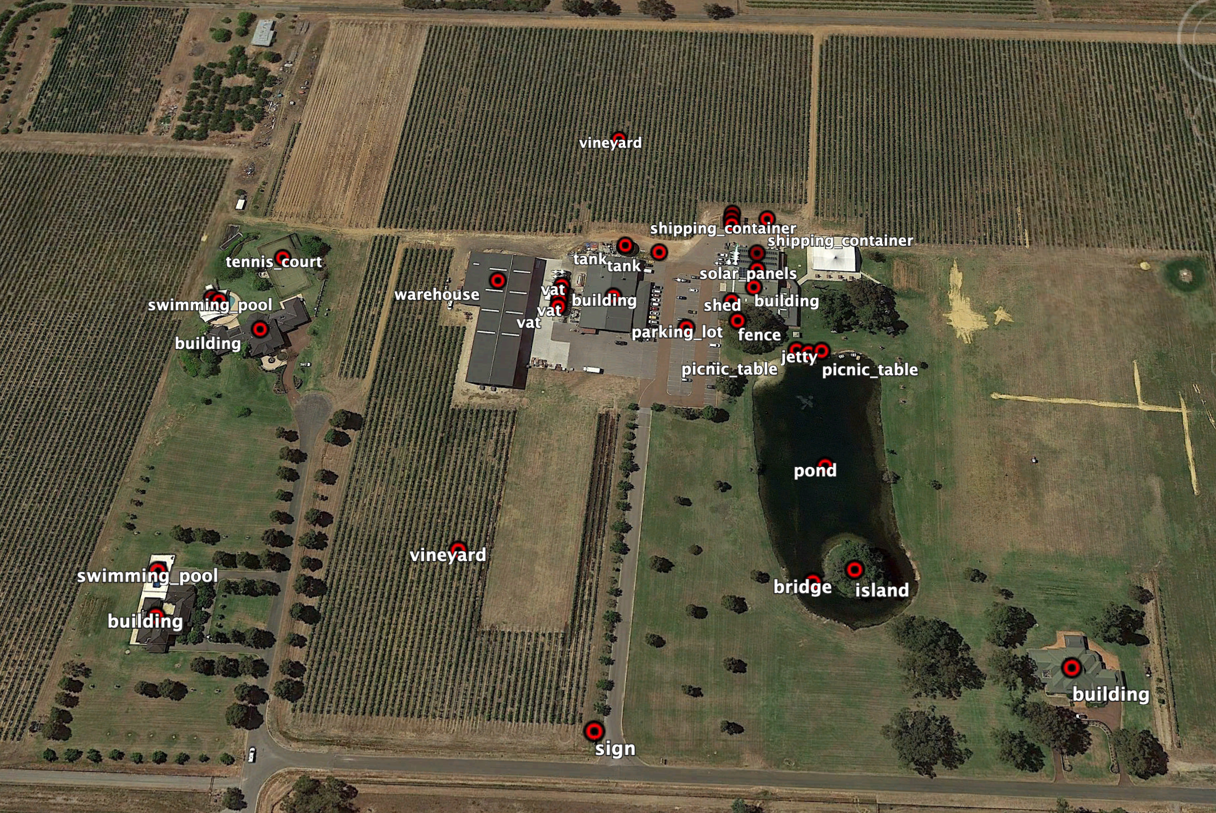
Data Acquisition
Hand-labeled ground truth data
OpenStreetMap labeled data
Automatically detected objects
Notes:
Left: KML That we hand-labelled
Right: Locations we added to OSM

Slide 8
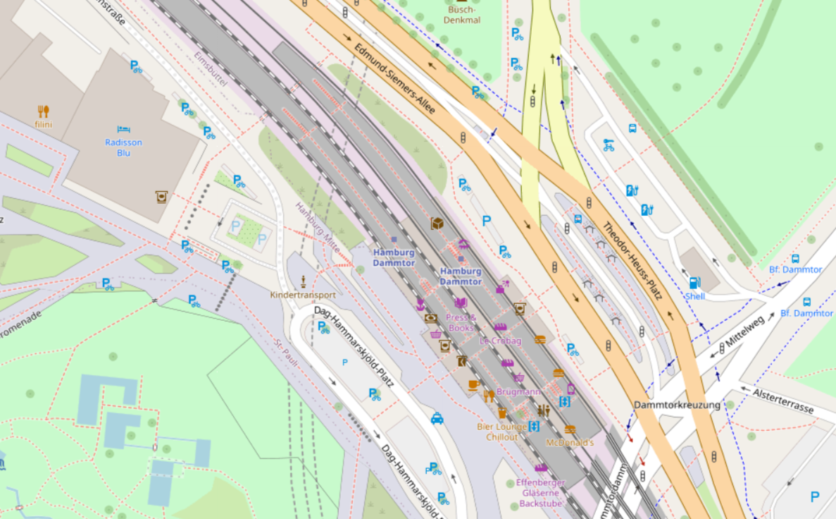
Data Acquisition
Hand-labeled ground truth data
OpenStreetMap labeled data
Automatically detected objects
✖
✖
✖
✖
↑
←
Locations
Objects
Notes:
Right: We Get OSM Data primarily by querying nodes, and filtering out things that have addresses, phone numbers etc.
We then take the inverse set, things with addresses, phone numbers etc as locations.

Slide 9
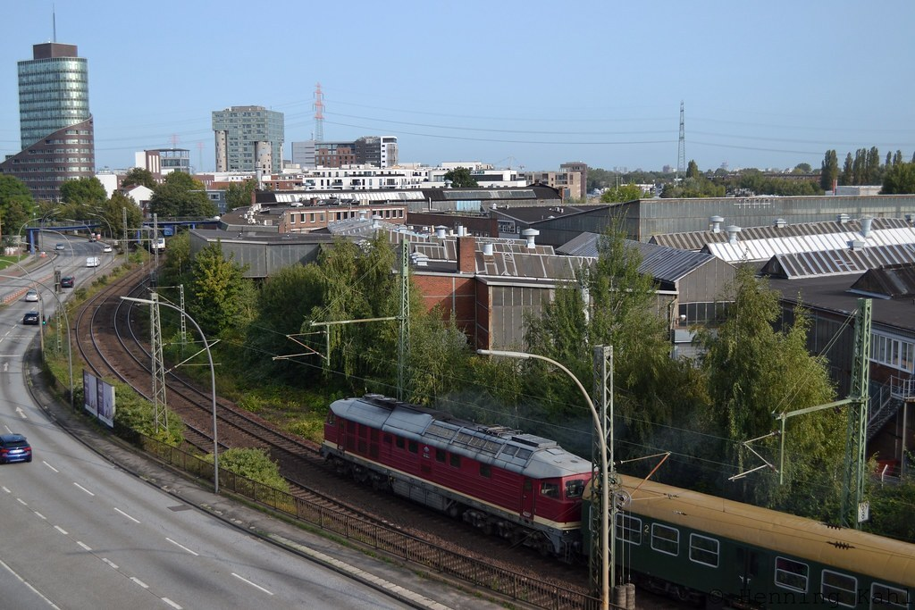
Data Acquisition
Hand-labeled ground truth data
OpenStreetMap labeled data
Automatically detected objects
tree
tree
lamp post
tree
lamp post
🔻
🔻
🔻
🔻
🔻
🔻
🔻
🔻
Notes:
We use YOLOv8 trained on MS COCO to classify objects (indicated here).
The general idea is that while human labelling is best, it is expensive. Even when available from crowd workers.
Recognizing things from above is hard, but there are large numbers of publicly available photos.
We want to leverage the incidental work people do.
We tag objects and then estimate their position based on the EXIF data in the photos.
We hope to extend this work towards scene reconstruction, adding in depth estimates, orientation data from the EXIF and reconciling it with RSI
It gives us what is on the left. For our demos we query FLICKR

Slide 10
GESTALT Architecture
Data collection, Ownership-Assignment, and User Interface
Notes:
We are looking at three components:
Data Collection
Ownership Assignment
UI

Slide 11
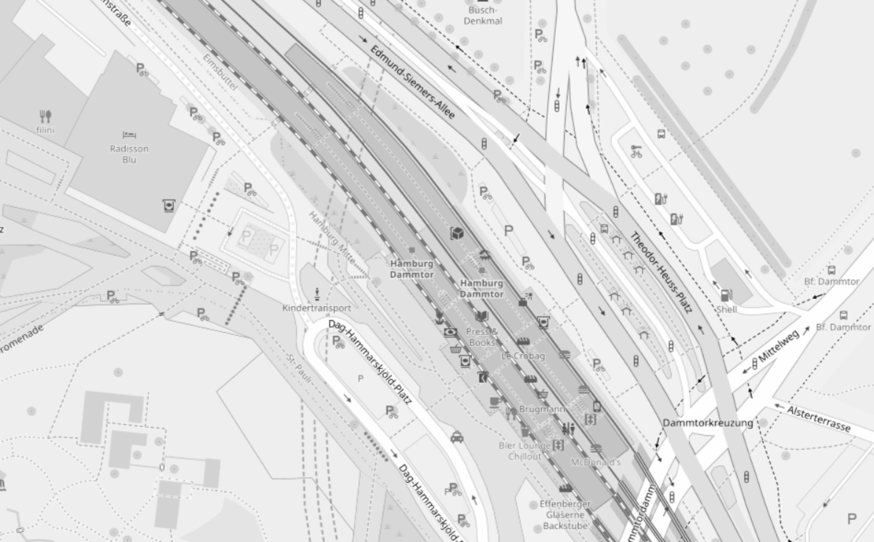
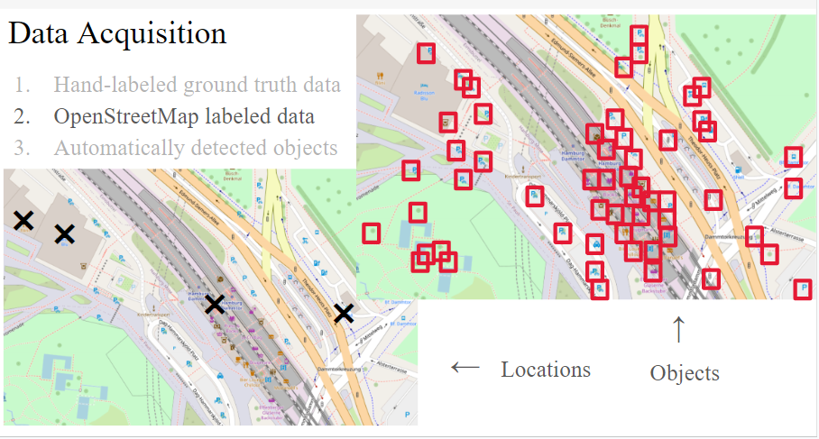
Object-Ownership Assignment
Objects are assigned to nearby locations using density-based clustering, allowing for noise in the objects and locations tagged
Probabilistic assignment
Fuzzy assignment
✖
✖
→
✖
✖
Notes:
We spoke earlier about the hierarchy of Region, Location, Object.
Locations are assigned to a region by bounding box membership, but objects to locations are harder.
Locations vary hugely in size and density.
Rarely does the semantic centre of a location line up with the centroid of the objects clustered around it.
They are weird shapes
Their boundaries can be fuzzy, what really is a location anyway? Here some objects could readily be owned by the green or the blue location
So, how to cluster?
We tried K-Means but we either need to know the number of locations apriori (which he do, but not the density distribution), and the weird shapes didn’t work.
We found that DBScan does quite well at the clustering for locations, as it can trim out the noise as well as build odd clusters. It still doesn’t do great with large variance in density.
We think that using the locations as seeds for a DBSCAN style algorithm could be successful.

Slide 12
GESTALT Architecture
Data collection, Ownership-Assignment, and User Interface
Notes:
We are looking at three components:
Data Collection
Ownership Assignment
UI

Slide 13
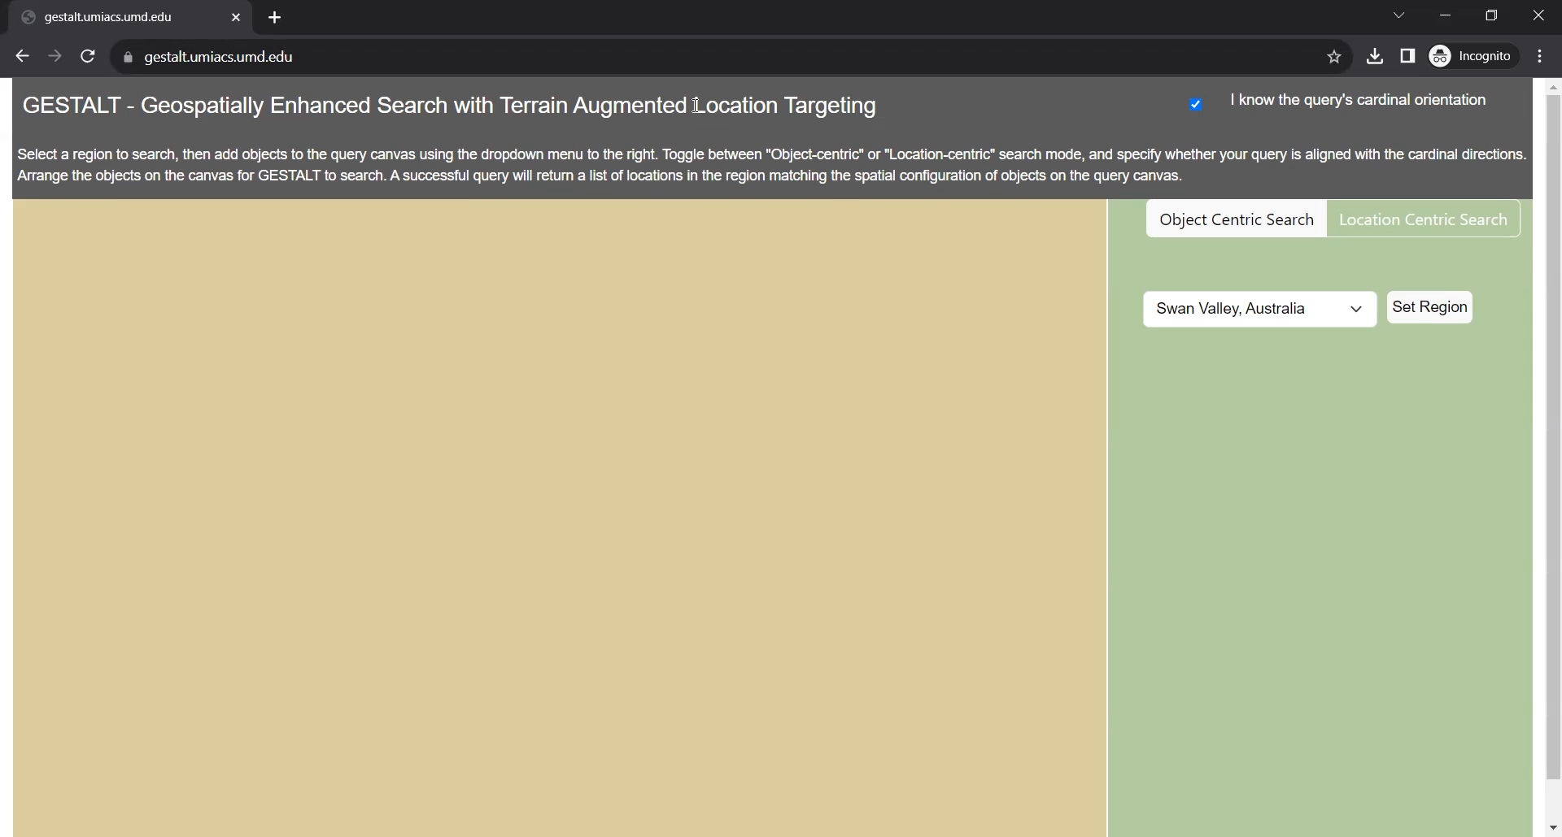
UI Demo
https://gestalt.umiacs.umd.edu/

Slide 14
GESTALT Architecture
Data collection, Ownership-Assignment, and User Interface
Notes:
We are looking at three components:
Data Collection
Ownership Assignment
UI

Slide 15
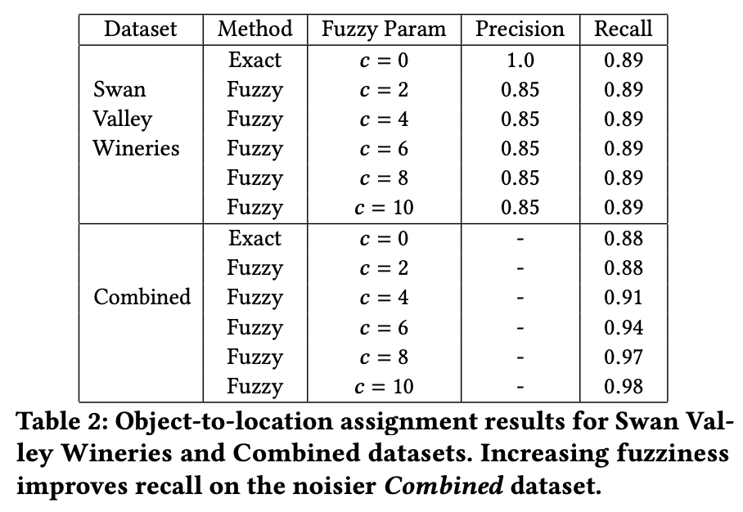
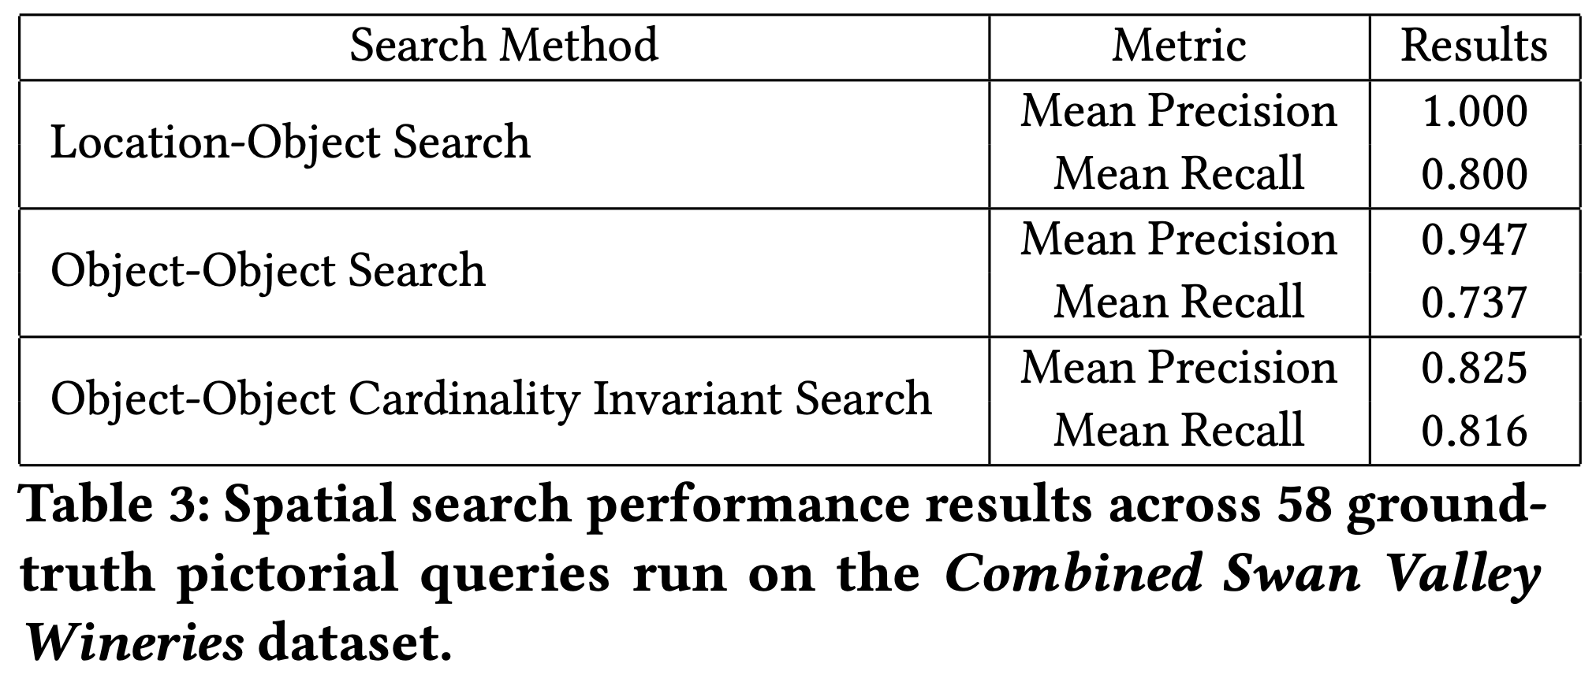
Experiments - effectiveness
Notes:
Is this actually good at it’s job?
We tested on hand-labelled data in an admittedly fairly sparse area.
Search Types:
SO WHAT:
Fuzziness does what we expect it to, recall gets better but still isn’t perfect
Our second talk later this afternoon will go more into each of the search methods.

Slide 16
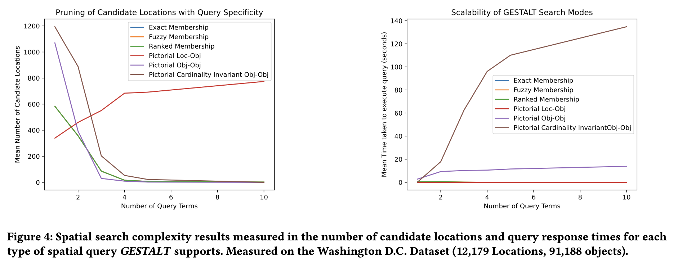
Experiments - efficiency
Notes:
Can it work well>
Not in current inefficient implementation, but testing of backend itself shows good promise:
Selectivity of query terms is very good.,
Efficiency in practice is much better than worse-case

Slide 17
What next?
Discussion of our Data Structures and Search Algorithms in GeoSearch @ 1550 today.
Future Work:
Data collection → Flickr is great, but not `general’ enough.
Data processing → Depth estimation for photos; refine object classes.
Clustering → Clustering around known `centroids’ & learn parameters.
UI → Links to locations, return map thumbnails, enforce ontology.
User Study → Confirm assumptions about utility.

Slide 18
Questions
Kent O’Sullivan | osullik@umd.edu
Nicole R Schneider | nsch@umd.edu
Hanan Samet | hjs@cs.umd.edu

